Slide 1

THEORY OF
MECHANISMS

Slide 2
GROUP 4
Abesech me21b003
Darshan me21b051
Gyothirram me21b071
Jayaram me21b079
ritesh me21b162

Slide 3
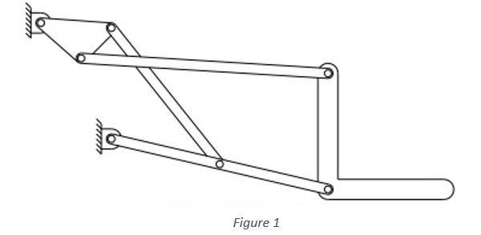
OUR MECHANISM
1

Slide 4
6 BAR
LIFTER
The linkage is in fact an inversion of Stephenson’s mechanism, and one of the ternary links acts as our input.
Vertically lifts a load using a rotary input.
2

Slide 5
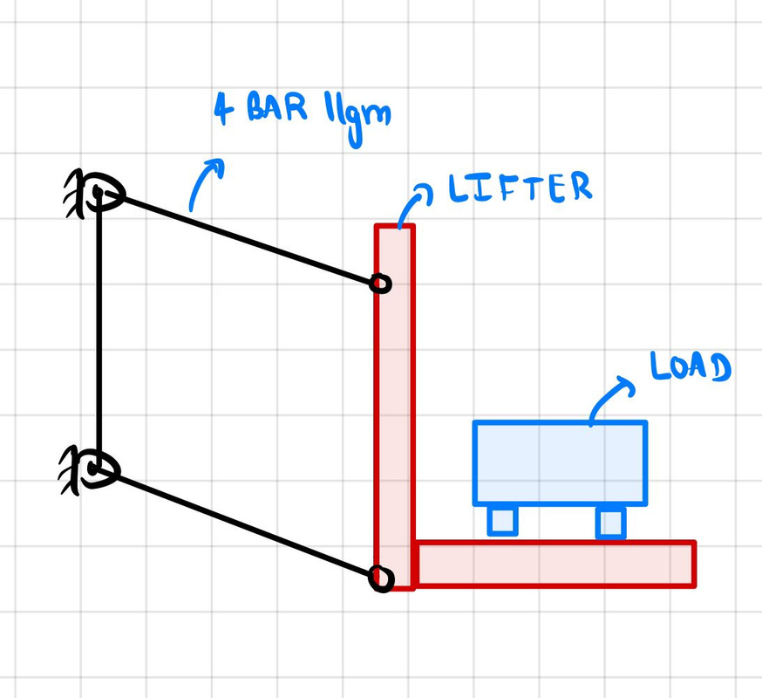
Why are we not using a simple parallelogram?
This limits the lifter’s range of motion and its payload capacity.
This is harder to control.
MA is better with a 6 bar.
3

Slide 6
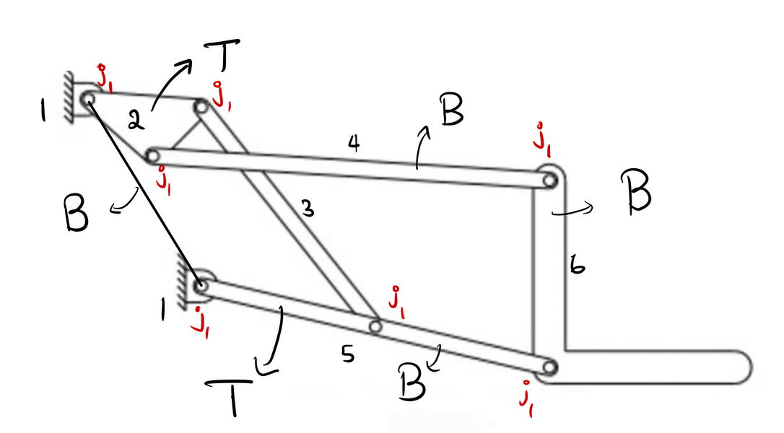
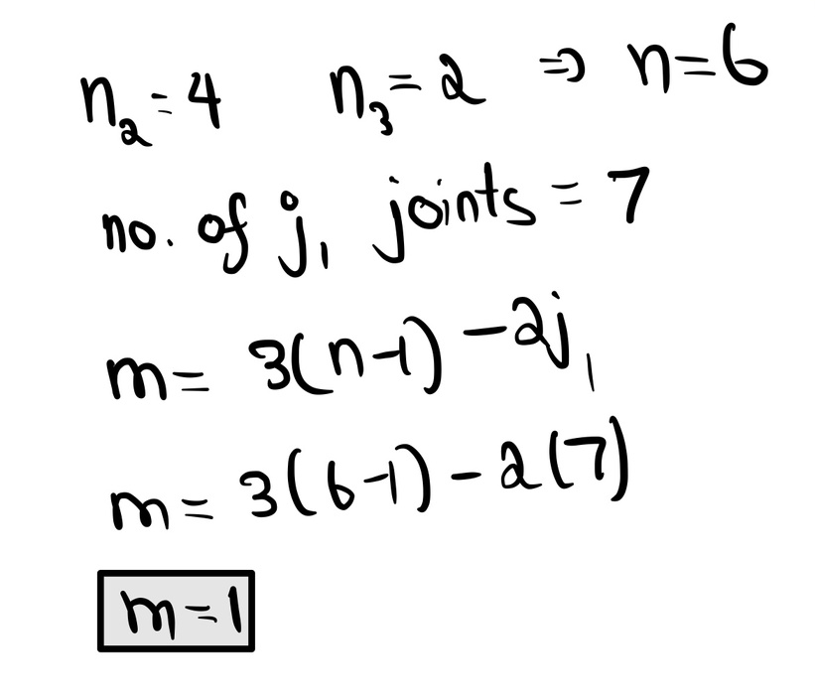
MOBILITY ANALYSIS
Our lifter has 2 ternary links, 4 binary links, and a mobility of 1.
T - ternary links, B - binary links
4

Slide 7
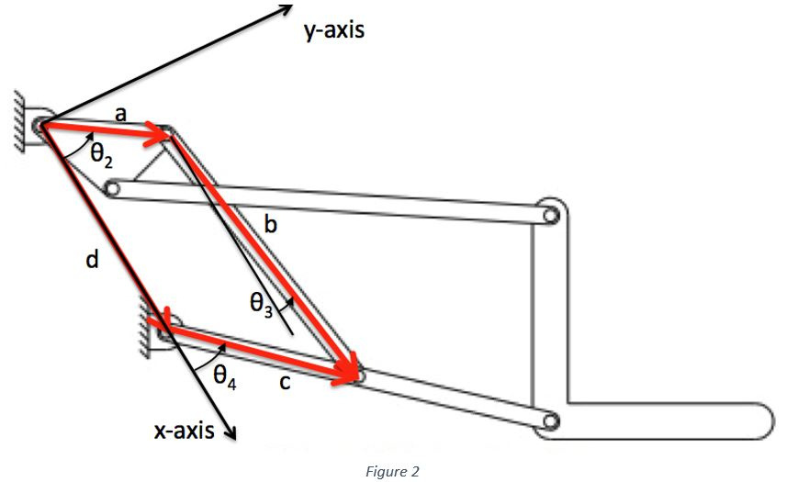
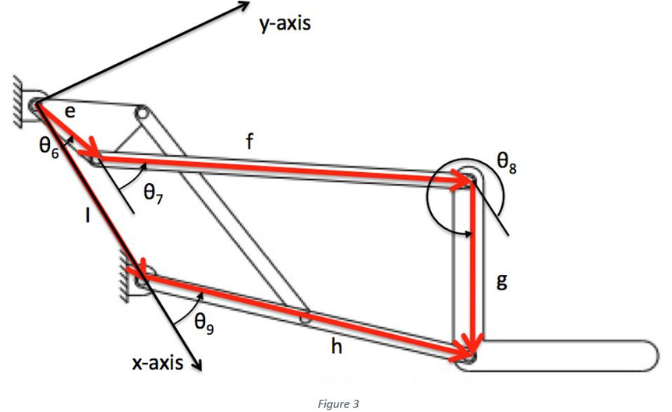
POSITION ANALYSIS
The ground link supports a 4 bar and a 5 bar
the 4 bar drives the 5 bar
5

Slide 8
Steps Involved
PART 1
Dyad Form - write the dyad form and loop closure equations.
DYAD FORM
SYNTHESIS
Constraints and Free Choices - the lifter’s orientation does not change
Synthesis using dyad form equations and free choices.
Results - solving equations with our choices and constraints
6

Slide 9
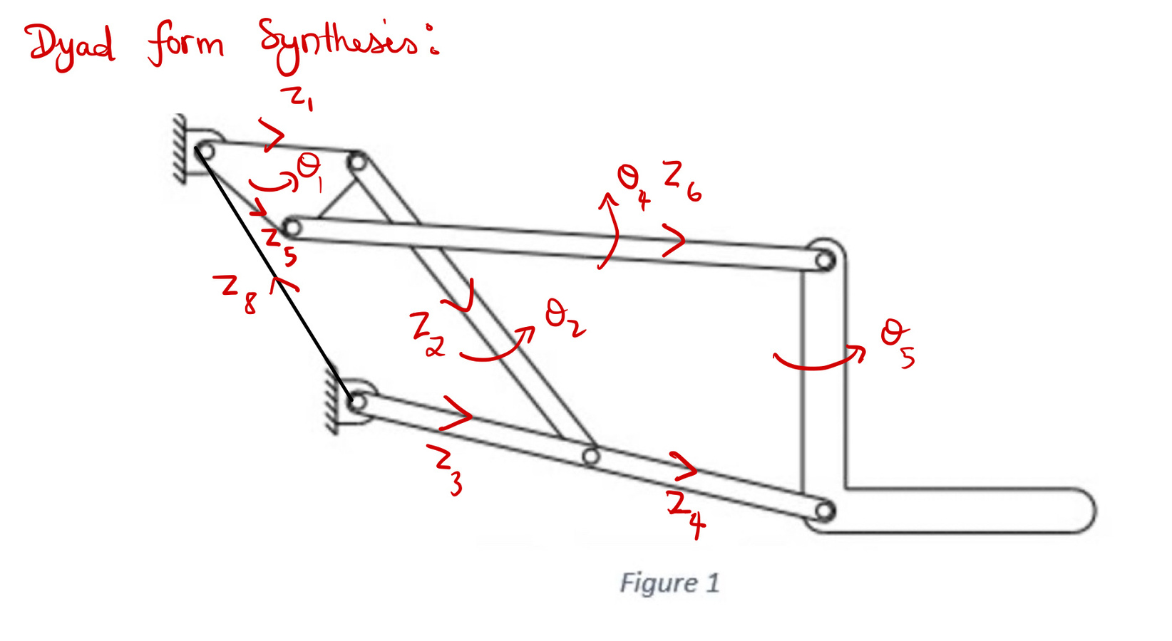
DYAD FORM EQUATIONS
7

Slide 10
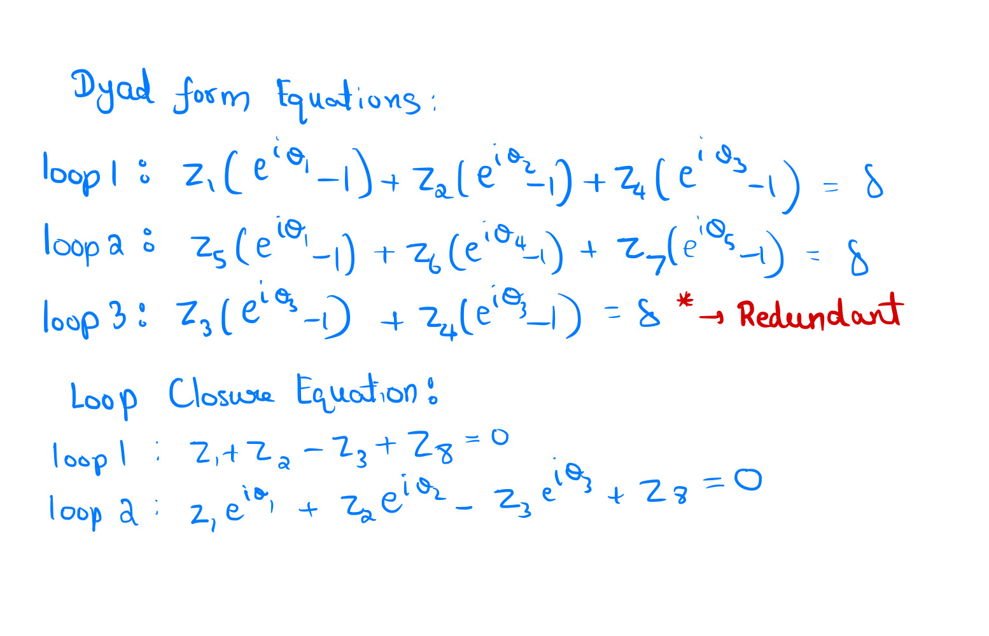
DYAD FORM EQUATIONS
8

Slide 11
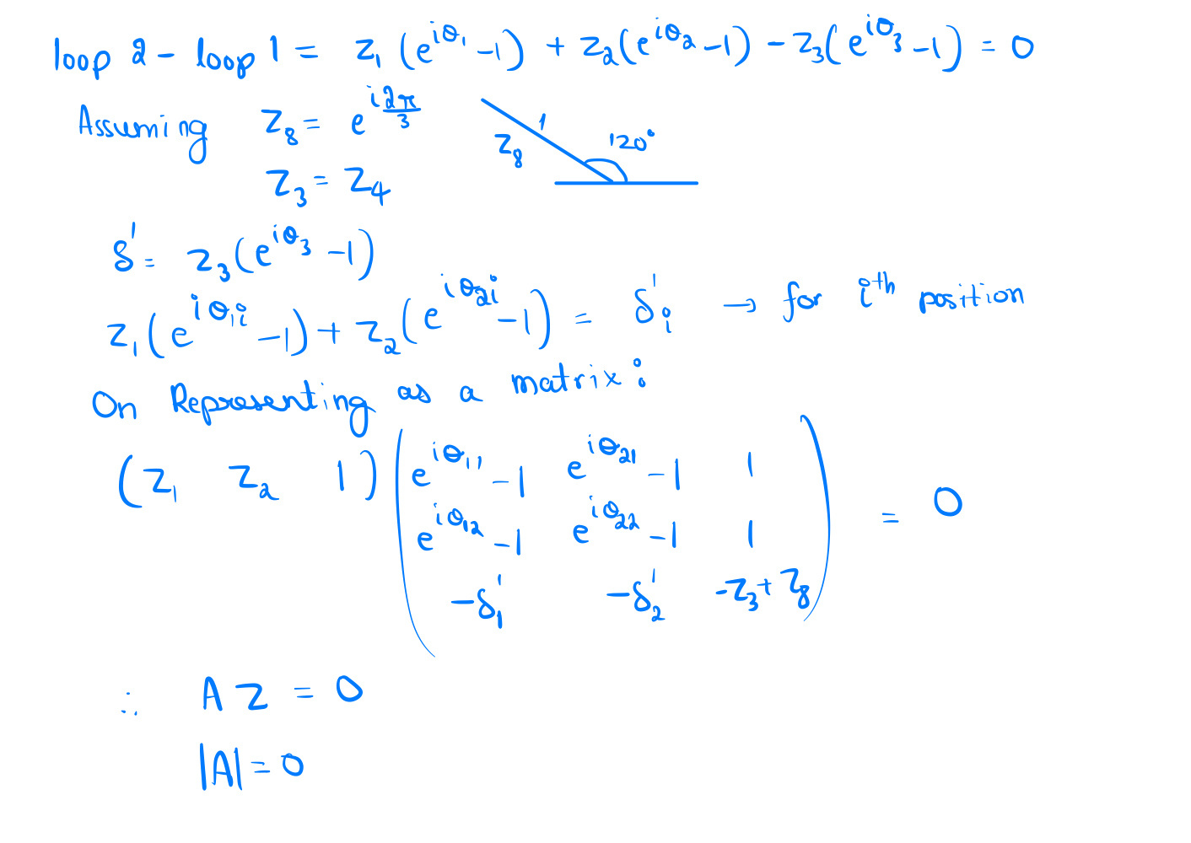
SOLVING...
9

Slide 12
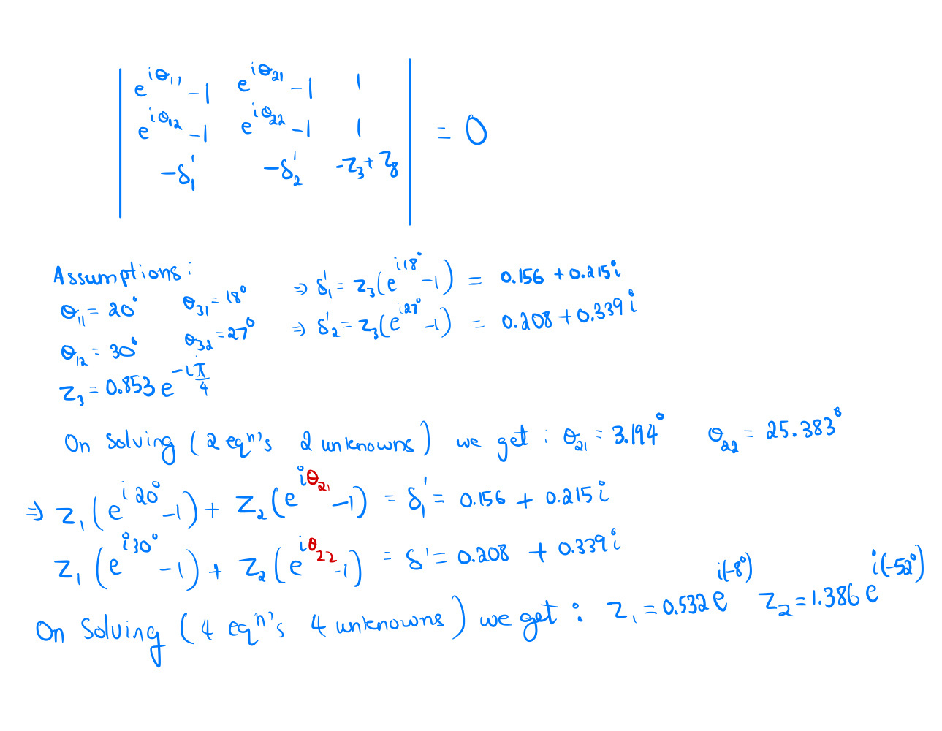
SOLVING...
10

Slide 13
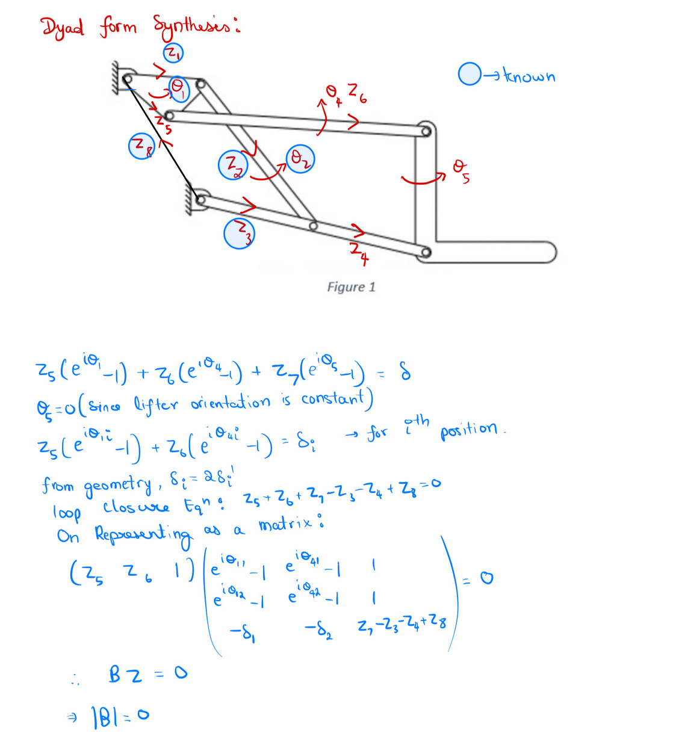

SOLVING...
Similar to the previous method, we solve for the remaining unknowns using the following determinant:
11

Slide 14
RESULTS
We took the ground link to be 30° to vertical
Scaling to a reasonable level
Z1=25.76
Z2=67.075
Z3=41.303
Z3+Z4=82.587 (link 5)
Z5=20.244
Z6=86.755
Z7=42.414
Z8=48.393
(all units are in cm)
12

Slide 15
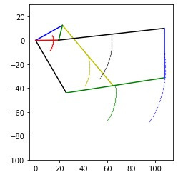
COG TRAJECTORIES
12

Slide 16
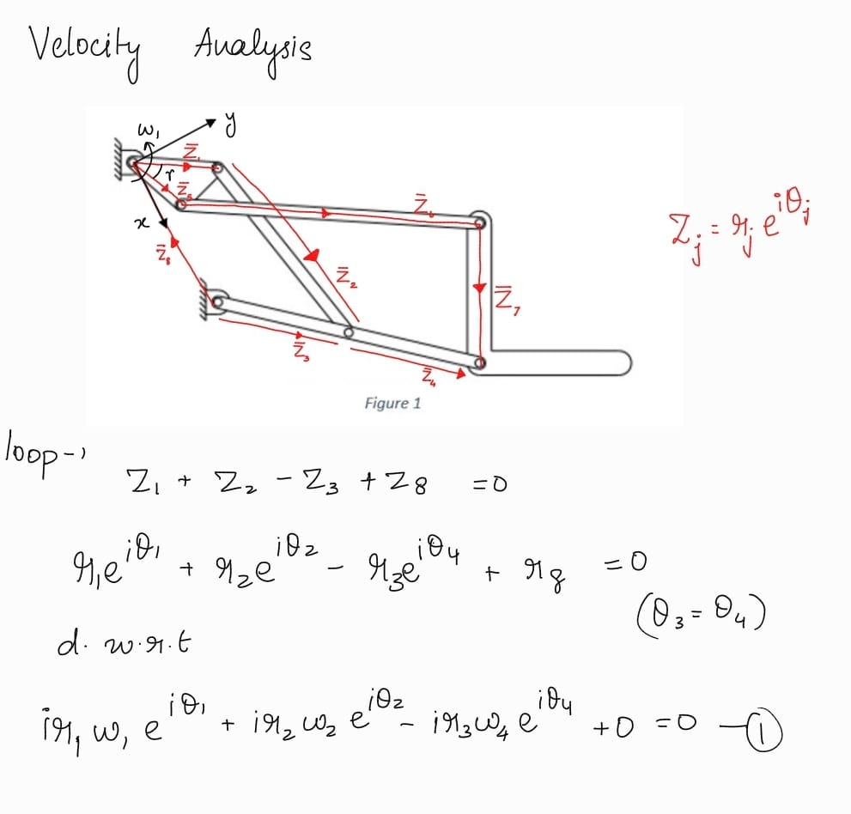
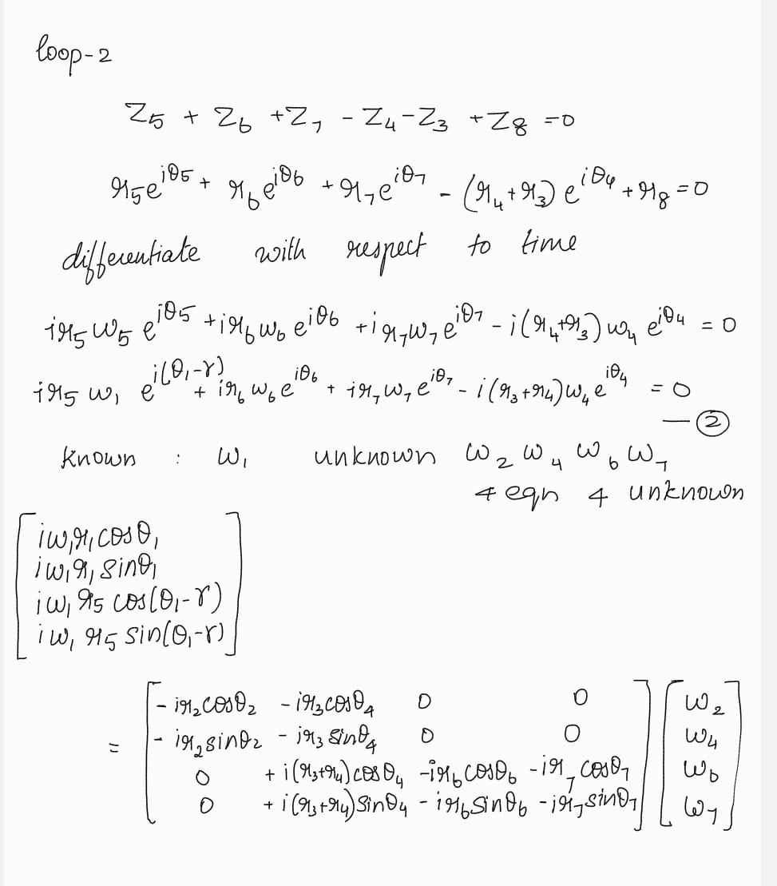
VELOCITY ANALYSIS
13

Slide 17
VELOCITY ANALYSIS
14

Slide 18
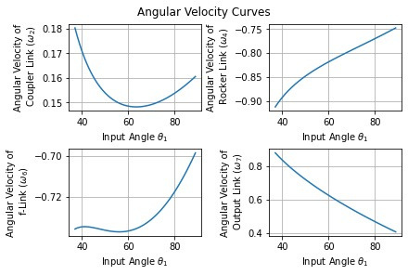
VELOCITY ANALYSIS
15

Slide 19
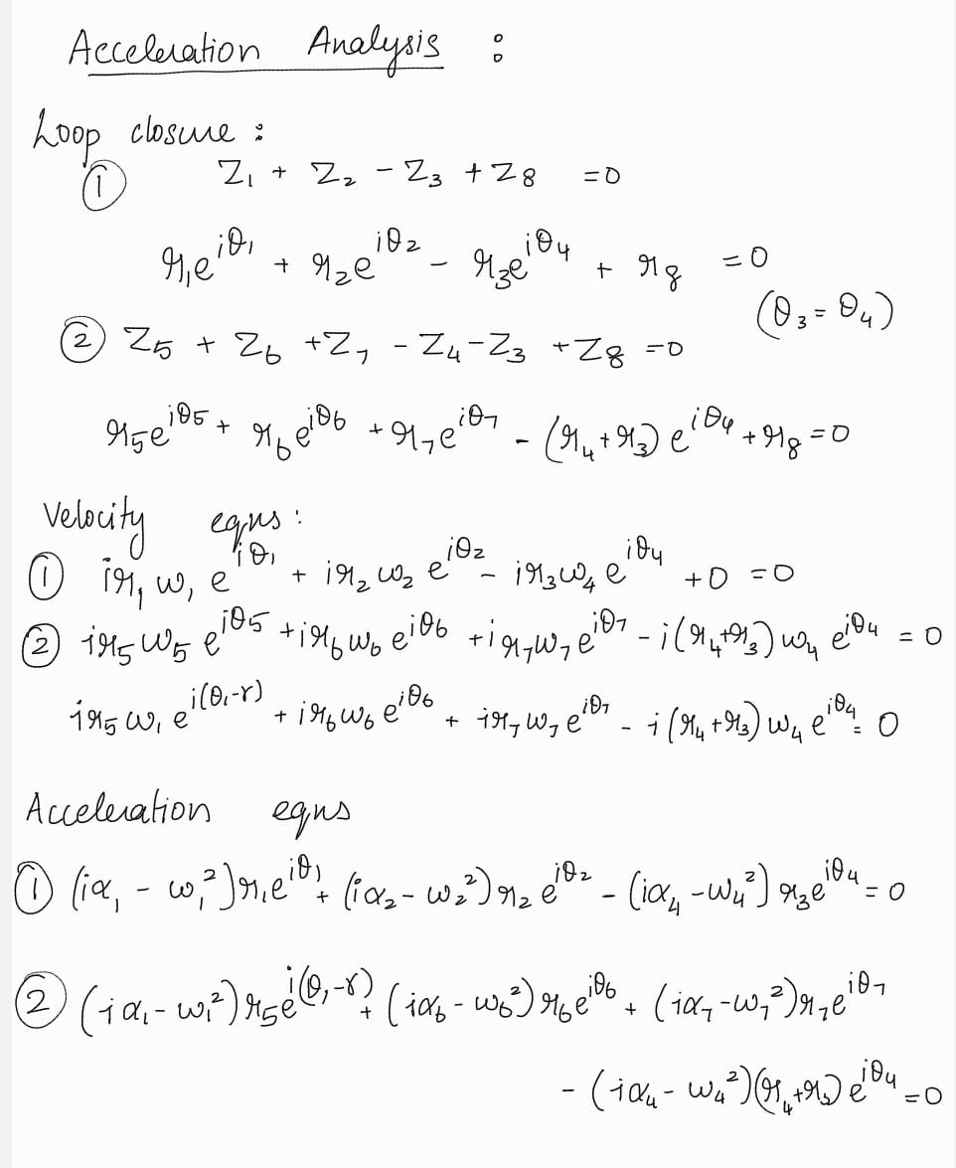
ACCELERATION ANALYSIS
16

Slide 20
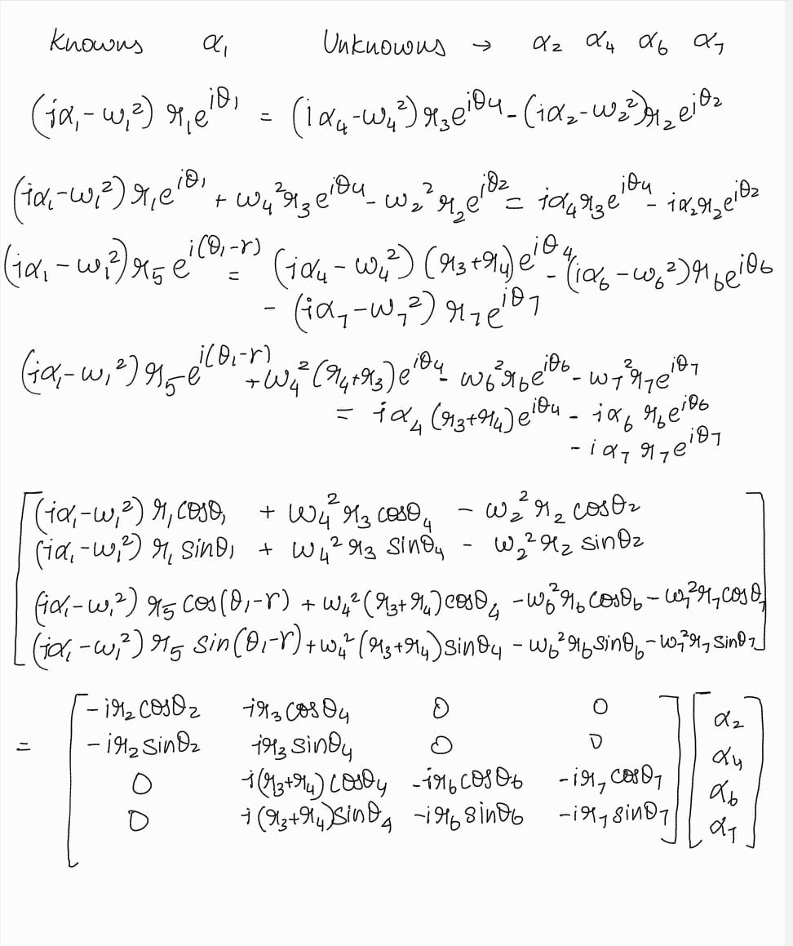
ACCELERATION ANALYSIS
17

Slide 21
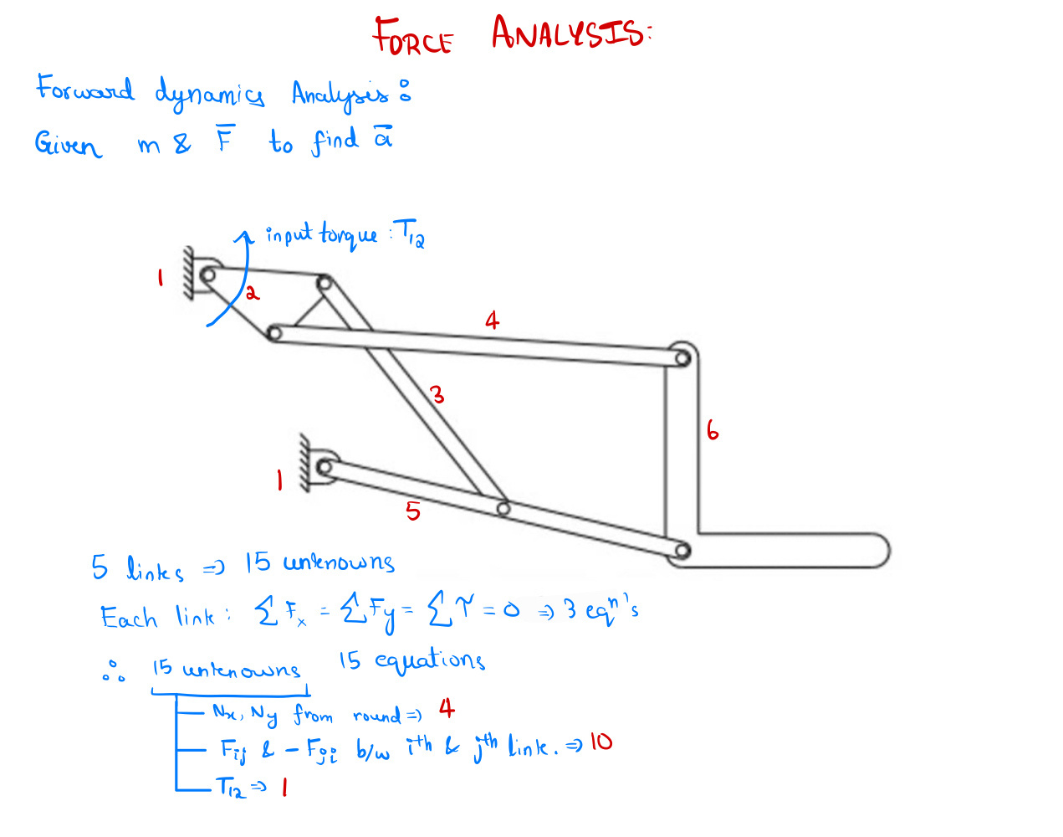
FORCE ANALYSIS
18

Slide 22
Steps Involved
PART 2
Geometrical Analysis - understanding how the mechanism is spaced out
SIMULATION
Constraints - the lifter’s orientation is constant
Synthesis using iterative methods.
Python Code - iteratively solving equations with the conditions
19

Slide 23
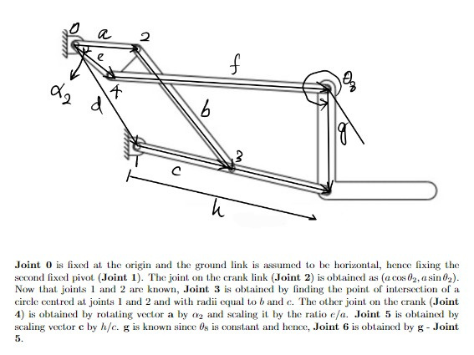
METHOD OF SIMULATION
The code iteratively generates 100 sets of 6-bar linkage link lengths within 5 units of the original lengths, validates them through position synthesis, and selects the configuration with the highest output link range of motion as the optimal solution.
20

Slide 24
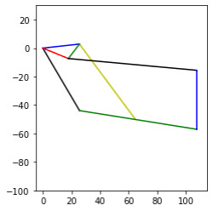
SIMULATION
With the results obtained in dyad form synthesis we used an iterative process to simulate the mechanism as shown in the figure.
21

Slide 25
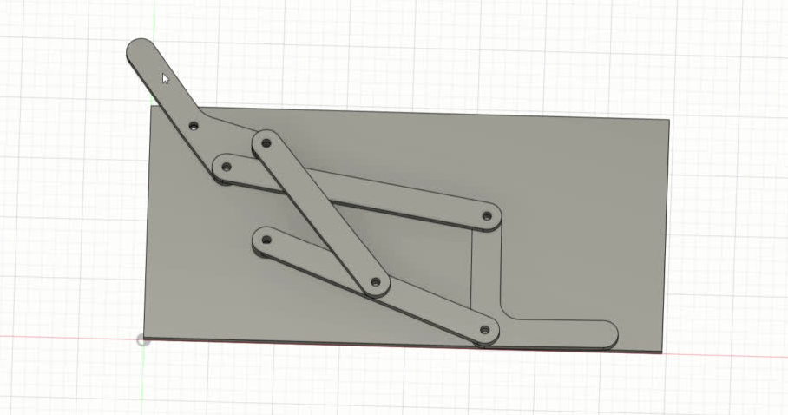
CAD MODEL
22

Slide 26
Thank You

